Slide 1
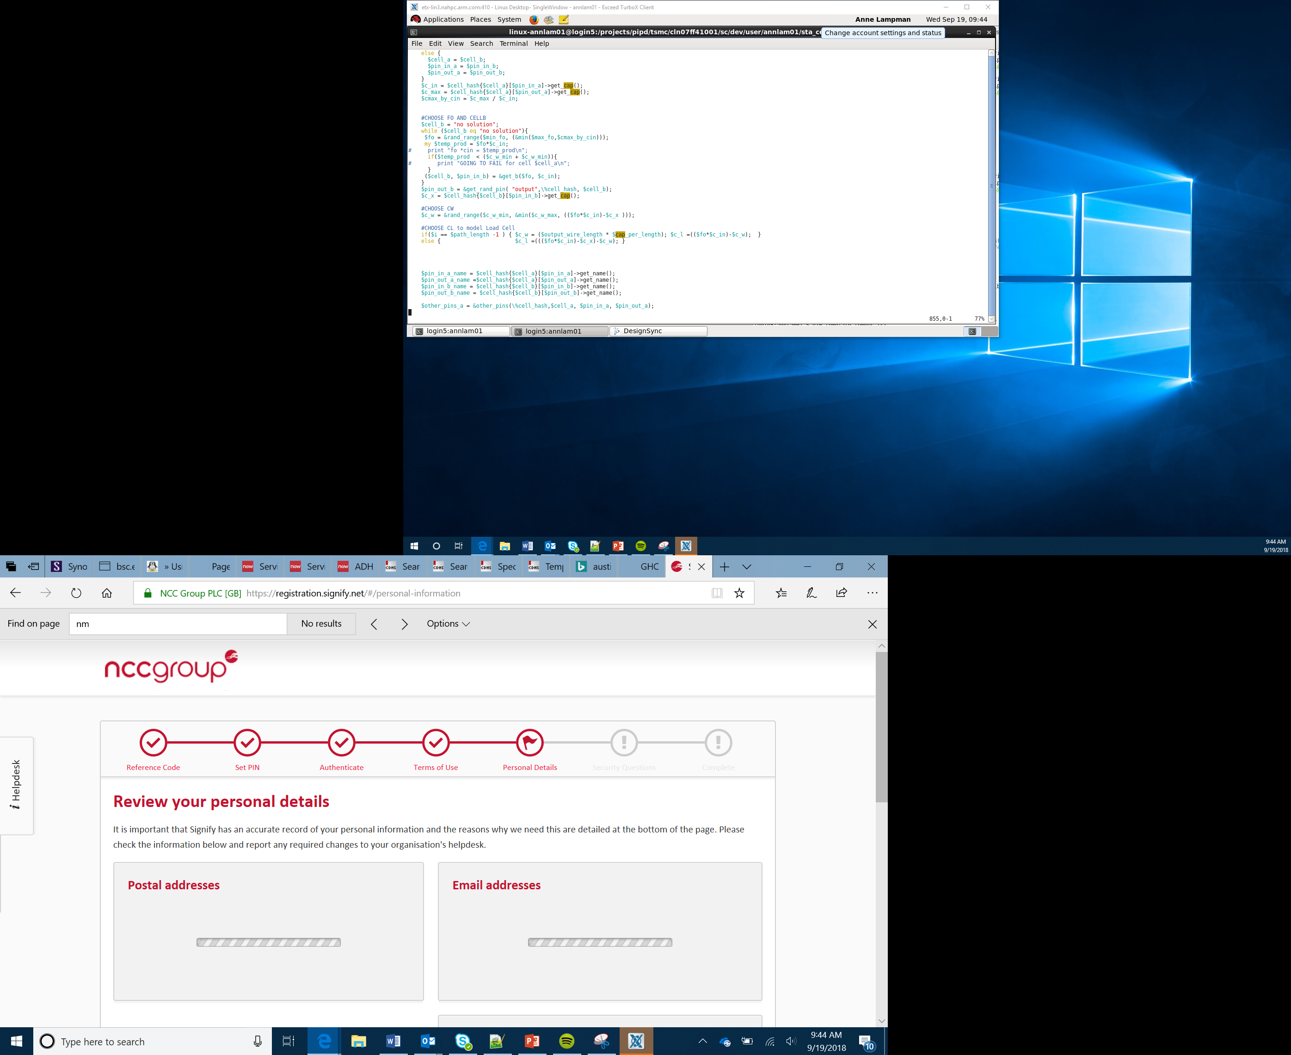

Ciphers, LCD and GPS
Lesson 6
Notes:
Introduce students to the overall purpose of the lesson. Today they will be combining LCD screens and a GPS sensor.

Slide 2
Radio communication
Mobile devices need to communicate with other devices
If you use a smartphone to connect to the internet you use radio waves to do this
The strength of the signal varies as you move further away from the transmitter
Physical objects which get in the way also reduce the signal strength
As the signal strength gets weaker the speed of the data transfer slows

Slide 3

Security
As information is being transmitted through the air, other people could intercept it
It is important that this information is kept secure so that if someone were to intercept it, they wouldn’t be able to understand it
To make sure the information is hidden this data is scrambled

Slide 4
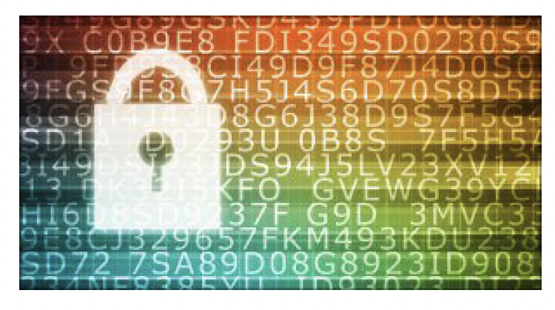
Encryption
The process of encoding data is known as encryption
To encrypt data, we apply a special algorithm called a cipher
The cipher is applied to the plain message so that it is scrambled

Slide 5
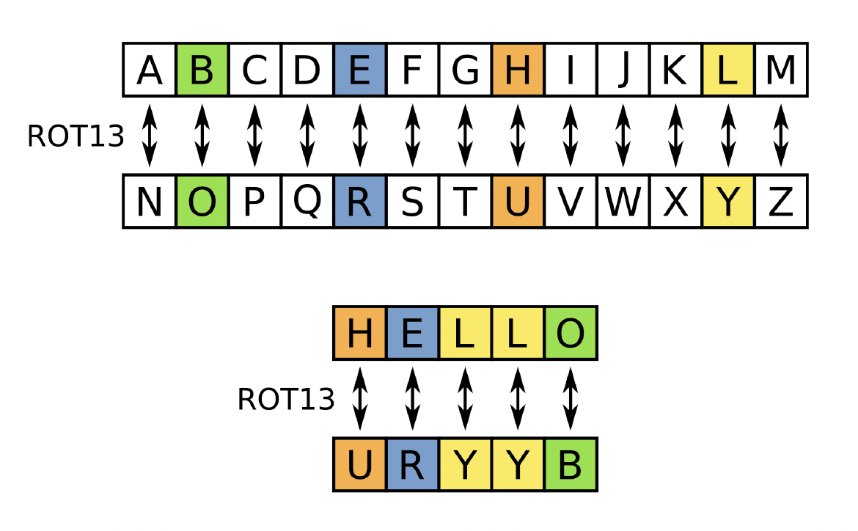
Caesar Cipher
One of the oldest encryption ciphers is called the ‘Caesar Cipher’. Julius Caesar used the cipher when sending messages
The cipher shifts each letter in the message by a specific number of characters to encrypt it
If the shift was +3 the word ‘HELLO’ would be encrypted to ‘URYYB’
Try to work through the Cipher worksheet to see if you can crack the secret message, and also come up with some of your own

Slide 6
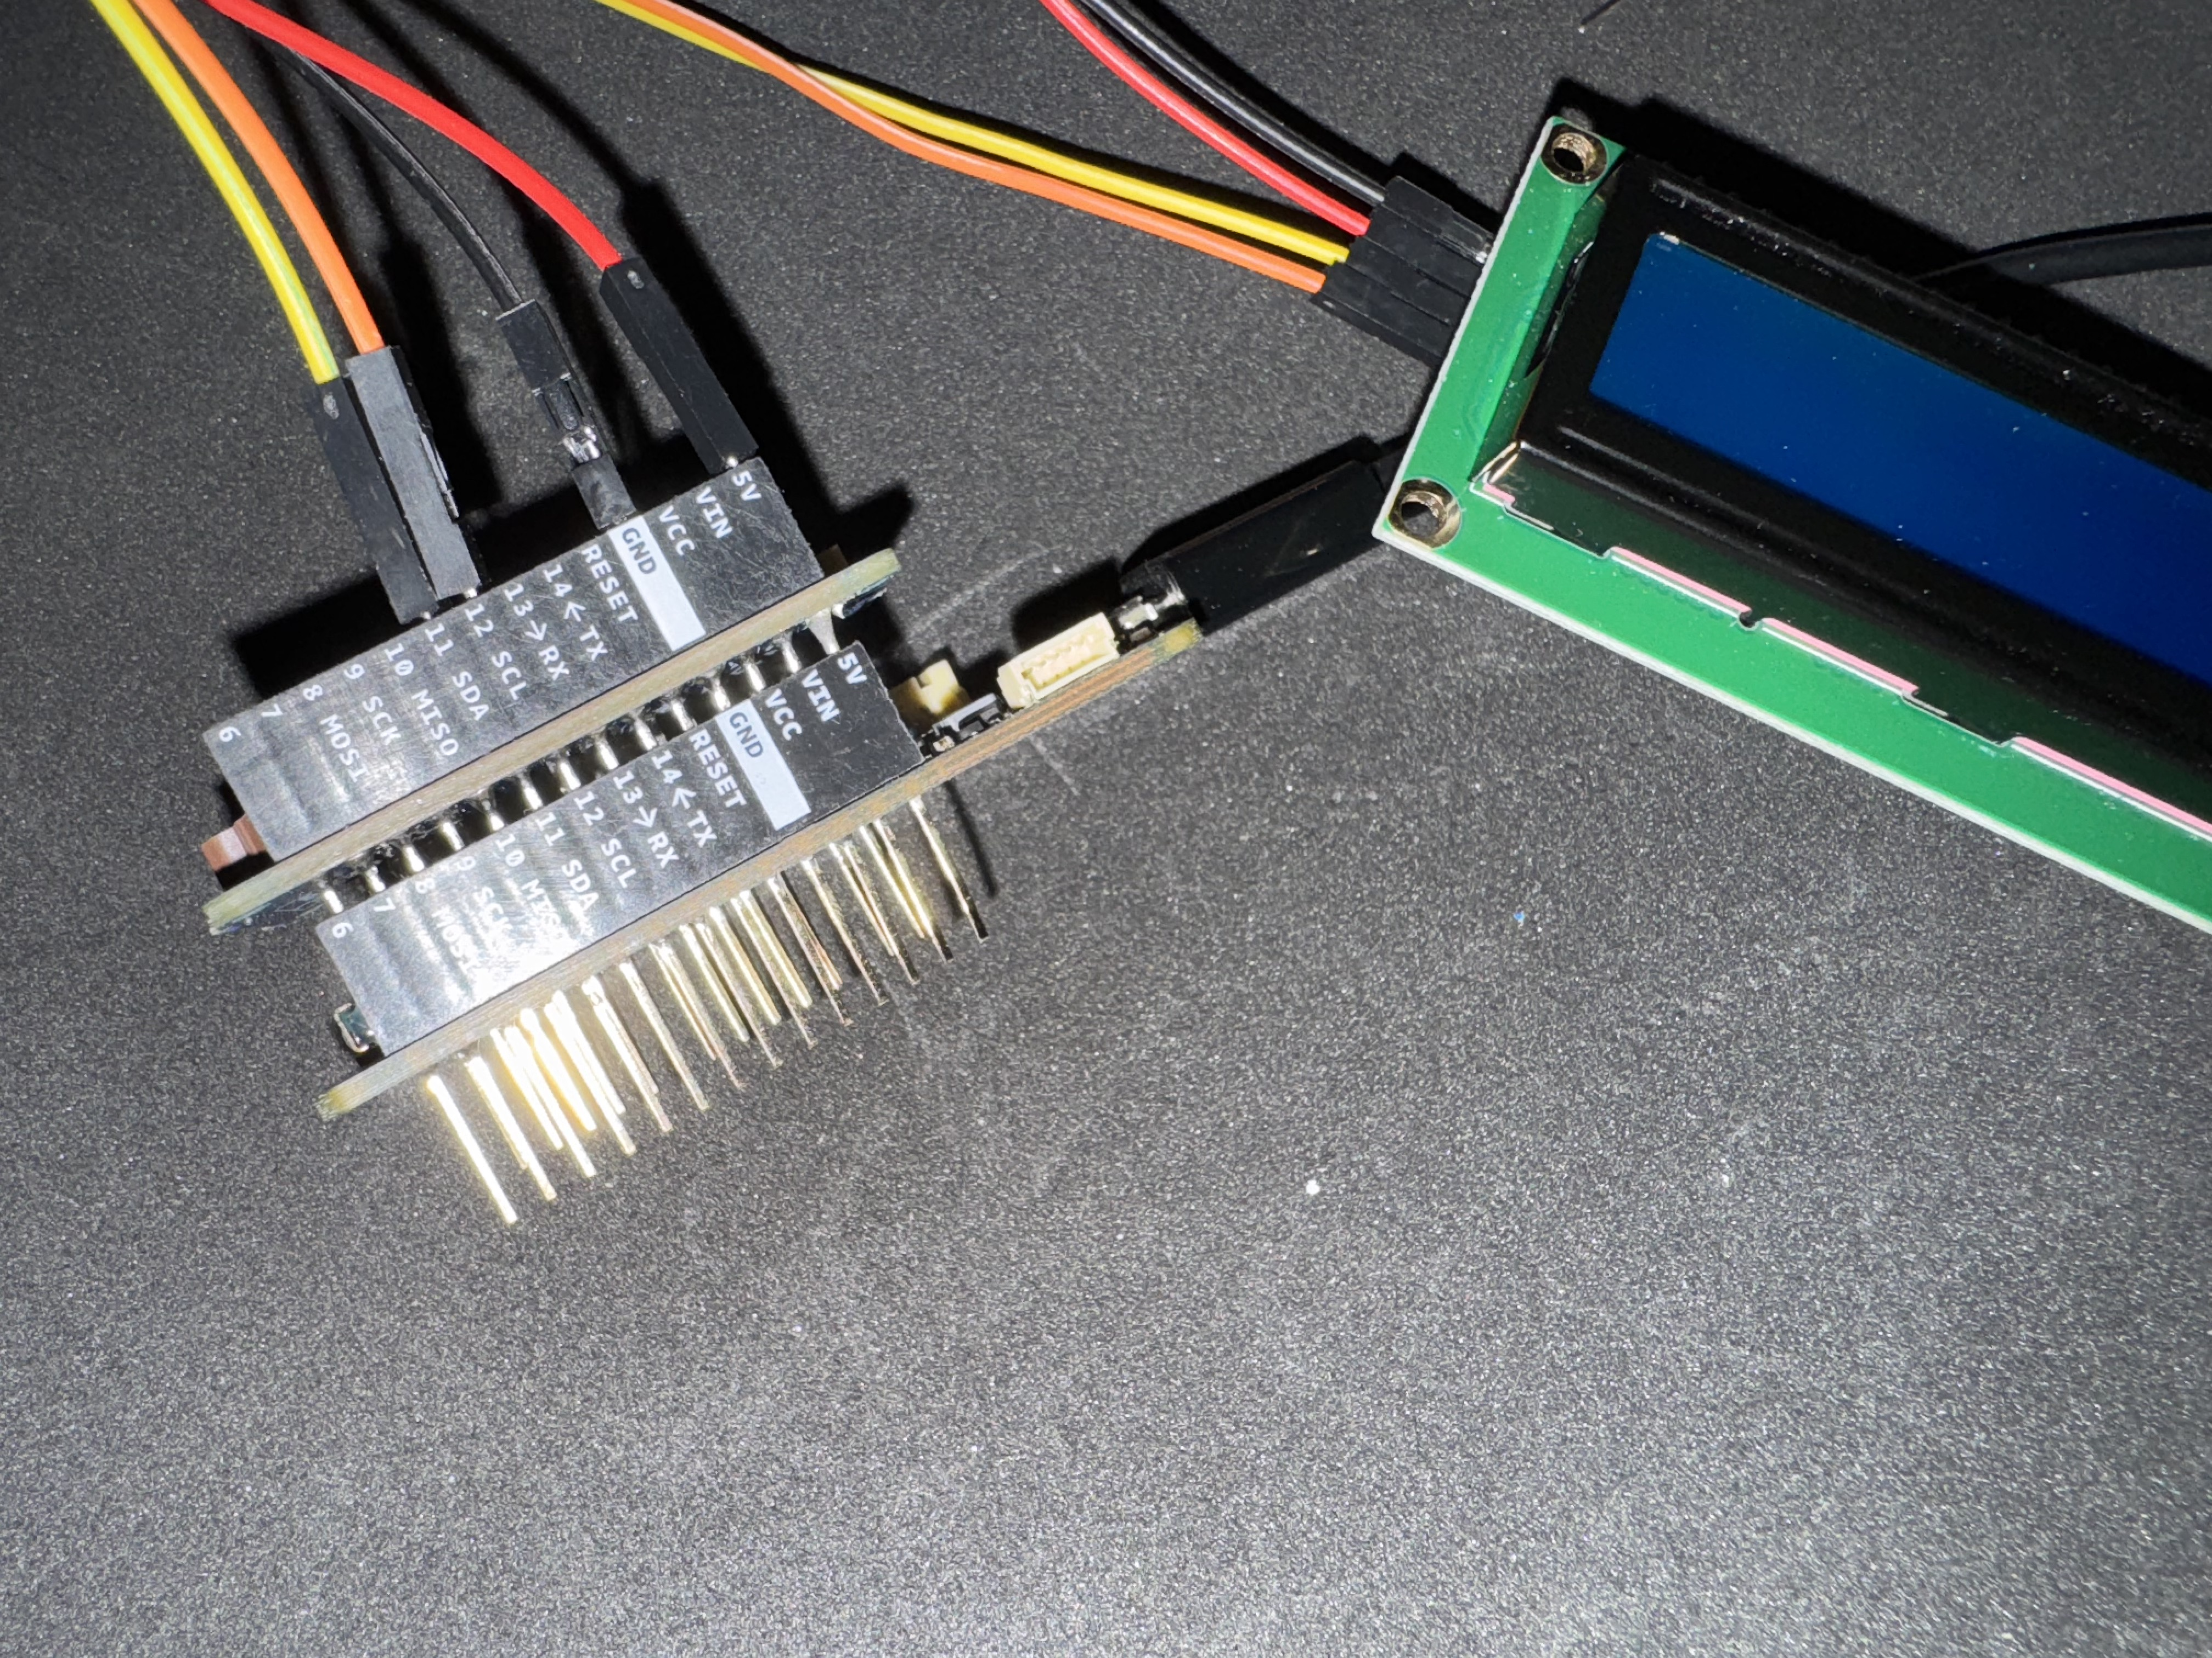
Connecting the LCD and GPS to the Arduino
You are going to create the circuit and then test the two individual elements
Connect the Arduino to the screen using the I²C connections.
Connect the GPS shield using the cable or by plugging it in using the header pins directly to the Arduino.

Slide 7
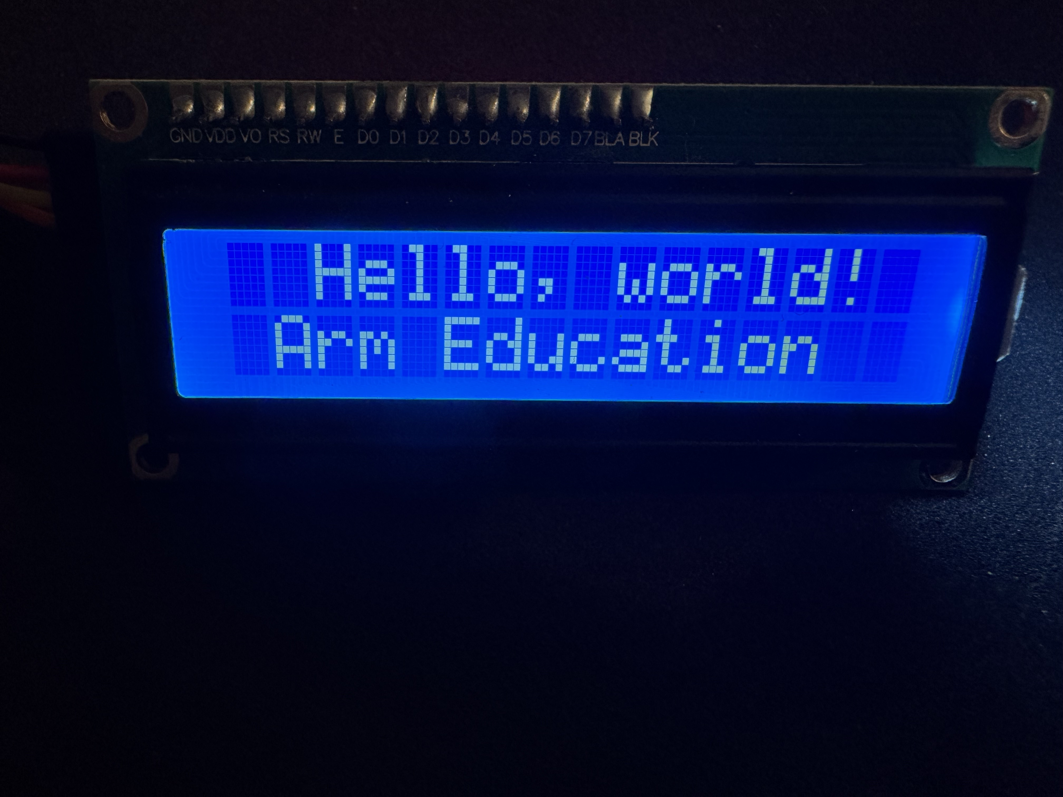
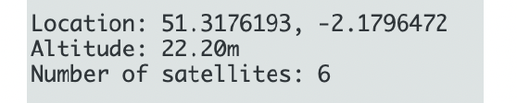
Testing your GPS and LCD screen
Upload the sample LCD file to your Arduino
If the circuit has been wired up correctly, it will a welcome message on the screen
Upload the sample GPS file to your Arduino. If it is working you should see the GPS coordinates displayed on the serial monitor.

Slide 8
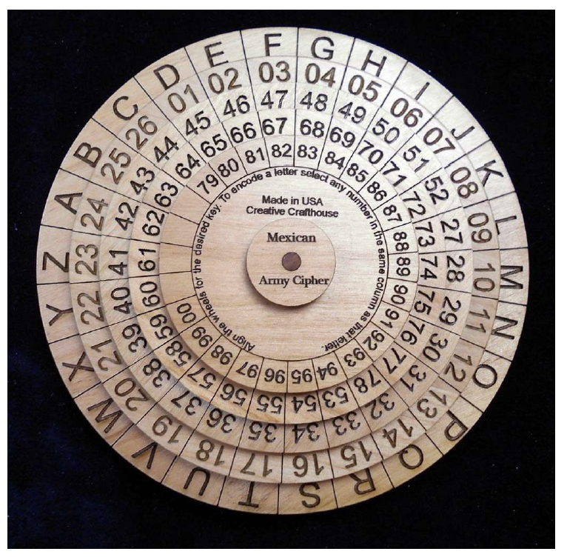
Challenge – treasure hunt
Write a secret message for one of your friends using a cipher of your own choice
Hide the message and record the GPS coordinates of where you have hidden it
Tell your friend the GPS coordinates of where the message is located. They should then use their GPS device to find the message and try to crack the code

